Slide 1
Linux Processes

Slide 2
Linux start up sequence
Loading and initialization of the kernel
Device detection and configuration
Creation of kernel threads
Operator intervention (manual boot only)
Execution of system startup scripts
Multiuser operation

Slide 3
Kernel initialisation
The Linux kernel is itself a program, and the first bootstrapping task is to get this program into memory so that it can be executed. The pathname of the kernel is usually /vmlinuz or /boot/vmlinuz. Linux implements a two-stage loading process. During the first stage, the system ROM loads a small boot program into memory from disk. This program then arranges for the kernel to be loaded. The kernel performs memory tests to find out how much RAM is available. Some of the kernel’s internal data structures are statically sized, so the kernel sets aside a fixed amount of real memory for itself when it starts. This memory is reserved for the kernel and cannot be used by user-level processes. The kernel prints on the console a message that reports the total amount of physical memory and the amount available to user processes.

Slide 4
Hardware configuration
One of the kernel’s first chores is to check out the machine’s environment to see what hardware is present. When you construct a kernel for your system, you tell it what hardware devices it should expect to find; when the kernel begins to execute, it tries to locate and initialize each device that you have told it about. The kernel prints out a line of cryptic information about each device it finds. These days, distributions include kernels that work on most machine configurations, requiring minimal (if any) customization.

Slide 5
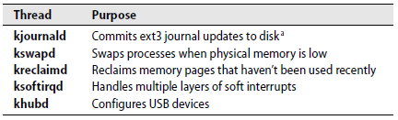
Kernel Threads
Once basic initialization is complete, the kernel creates several “spontaneous” processes in user space. They’re called spontaneous processes because they are not created through the normal system fork mechanism. The number and nature of the spontaneous processes vary from system to system. Under Linux, there is no visible PID 0.
init (always process 1) is accompanied by several memory and kernel handler processes.
These processes all have low-numbered PIDs and can be identified by the brackets around their names in ps listings (e.g., [kacpid]). Sometimes the process names have a slash and a digit at the end, such as [kblockd/0].
The number indicates the processor on which the thread is running, which may be of interest on a multiprocessor system.

Slide 6
Operator Intervention – manual boot
From the single-user shell, you can execute commands in much the same way as when logged in on a fully booted system. In some operating systems, only the root partition is usually mounted; you must mount other filesystems by hand to use programs that don’t live in /bin, /sbin, or /etc. In many single-user environments, the filesystem root directory starts off being mounted read-only.
The fsck command is normally run during an automatic boot to check and repair filesystems. When you bring the system up in single-user mode, you may need to run fsck by hand.

Slide 7
Execution of start up scripts
By the time the system is ready to run its startup scripts, it is recognizably Linux. Even though it doesn’t quite look like a fully booted system yet, no more “magic” steps are left in the boot process. The startup scripts are just normal shell scripts, and they’re selected and run by init according to an algorithm that, though sometimes tortuous, is relatively comprehensible.

Slide 8
Start up tasks
Some tasks that are often performed in the startup scripts are
Setting the name of the computer
Setting the time zone
Checking the disks with fsck (only in automatic mode)
Mounting the system’s disks
Removing old files from the /tmp directory
Configuring network interfaces
Starting up daemons and network services

Slide 9
Multi-user operation
After the initialization scripts have run, the system is fully operational, except that no one can log in. For logins to be accepted on a particular terminal (including the console), a getty process must be listening on it. init spawns these getty processes directly, completing the boot process. init is also responsible for spawning graphical login systems such as xdm or gdm if the system is set up to use them.
init continues to perform an important role even after bootstrapping is complete. init has one single-user and several multiuser “run levels” that determine which of the system’s resources are enabled

Slide 10
Run Levels
init defines seven run levels, each of which represents a particular complement of services that the system should be running:
Level 0 is the level in which the system is completely shut down.
Level 1 or S represents single-user mode.
Levels 2 through 5 are multiuser levels.
Level 6 is a “reboot” level.
Levels 0 and 6 are special in that the system can’t actually remain in them; it shuts down or reboots as a side effect of entering them. The general multiuser run level is 2 or 3.
The /etc/inittab file tells init what to do at each of its run levels. Its format varies from system to system, but the basic idea is that inittab defines commands that are to be run (or kept running) when the system enters each level.

Slide 11
Starting and Stopping services
To tell the system when to start a daemon, you must place symbolic links into the appropriate directory. For example, to tell the system to start CUPS at run level 2 and to stop it nicely before shutting down, the following pair of links would suffice:
# ln -s /etc/init.d/cups /etc/rc2.d/S80cups
# ln -s /etc/init.d/cups /etc/rc0.d/K80cups
The first line tells the system to run the /etc/init.d/cups startup script as one of the last things to do when entering run level 2 and to run the script with the start argument. The second line tells the system to run /etc/init.d/cups relatively soon when shutting down the system and to run the script with the stop argument.

Slide 12
Super user
Changing the root directory of a process with chroot
Creating device files
Setting the system clock
Raising resource usage limits and process priorities3
Setting the system’s hostname
Configuring network interfaces
Opening privileged network ports (those numbered below 1,024)
Shutting down the system

Slide 13
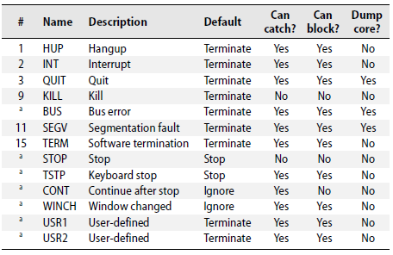
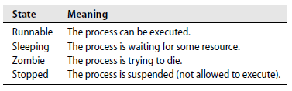
Processes – Signals, Interrupts, states

Slide 14
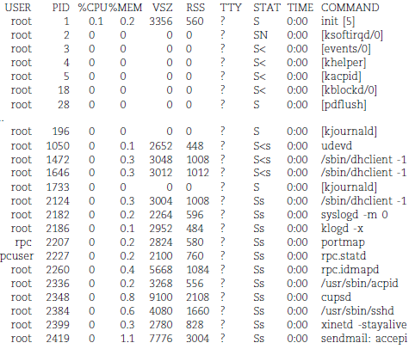
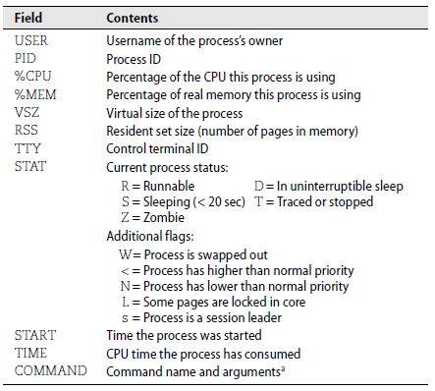
Processes

Slide 15
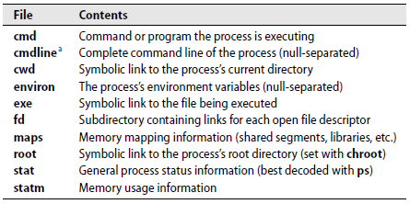
/proc filesystem

Slide 16
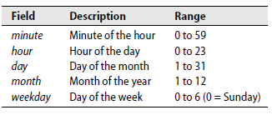
Cron - scheduler
Crontab files that schedule system maintenance tasks and other tasks defined by the system administrator are stored in the file /etc/crontab and in other files found in the /etc/cron.d directory. These files have a slightly different format from the peruser crontab files because they allow commands to be run as an arbitrary user.
Cron treats the /etc/crontab and /etc/cron.d entries in exactly the same way. In general, /etc/crontab is intended as a file for the system administrator to maintain by hand, whereas /etc/cron.d is provided as a place where software packages can install any crontab entries they might need.
All the crontab files on a system share a similar format. Comments are introduced with a pound sign (#) in the first column of a line. Each non comment line contains
six fields and represents one command:
minute hour day month weekday command
The time specification
45 10 * * 1-5
means “10:45 a.m., Monday through Friday.”

Slide 17
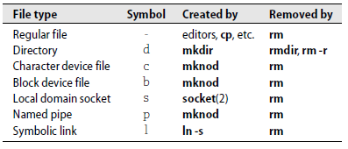
File Types

Slide 18
Character and Block Devices
Device files allow programs to communicate with the system’s hardware and peripherals. When the kernel is configured, modules that know how to communicate with each of the system’s devices are linked in. The module for a particular device, called a device driver, takes care of the messy details of managing the device.
Device drivers present a standard communication interface that looks like a regular file. When the kernel is given a request that refers to a character or block device file, it simply passes the request to the appropriate device driver. It’s important to distinguish device files from device drivers, however. The files are just rendezvous points that are used to communicate with the drivers. They are not the drivers themselves.
Character device files allow their associated drivers to do their own input and output buffering. Block device files are used by drivers that handle I/O in large chunks and want the kernel to perform buffering for them. In the past, a few types of hardware were represented by both block and character device files, but that configuration is rare today.
Device files are characterized by two numbers, called the major and minor device numbers. The major device number tells the kernel which driver the file refers to, and the minor device number typically tells the driver which physical unit to address. For example, major device number 6 on a Linux system indicates the parallel port driver. The first parallel port (/dev/lp0) would have major device number 6 and minor device number 0.

Slide 19
Local Domain sockets
Sockets are connections between processes that allow them to communicate hygienically. Linux provides several different kinds of sockets, most of which involve the use of a network. Local domain sockets are accessible only from the local host and are referred to through a filesystem object rather than a network port. They are sometimes known as “UNIX domain sockets.”
Although socket files are visible to other processes as directory entries, they cannot be read from or written to by processes not involved in the connection. Some standard facilities that use local domain sockets are the printing system, the X Window System, and syslog.

Slide 20
Named Pipes
Like local domain sockets, named pipes allow communication between two processes running on the same host. They’re also known as “FIFO files” (FIFO is short for the phrase “first in, first out”). You can create named pipes with mknod and remove them with rm.

Slide 21
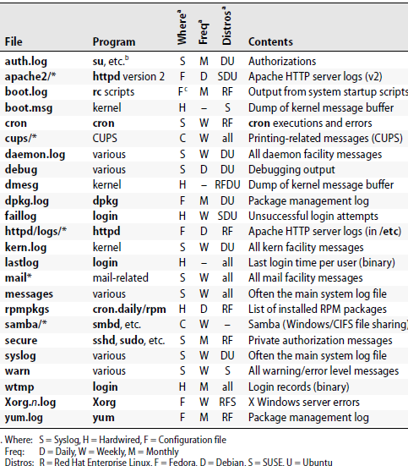
Log Files
Usually stored in /var/log

